Slide 1
Abstraction in Java
momedaram

Slide 2
Abstraction In java
Abstraction is a process of hiding the implementation details and showing only functionality to the user.
Abstraction is the process of separating ideas from their action.
Abstraction in java is implemented using:
Abstract classes
Interfaces.

Slide 3
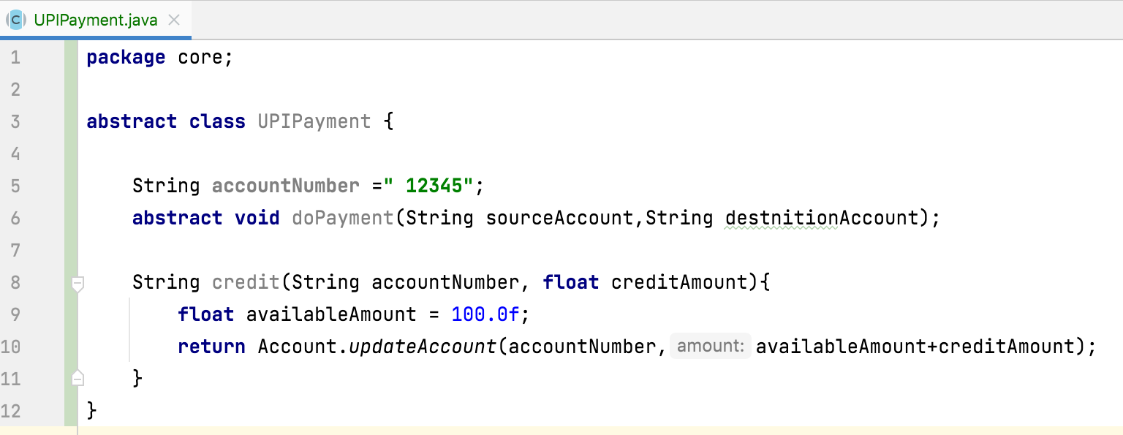
Abstract Class
A class which is declared as abstract is known as an abstract class
It can have abstract and non-abstract methods.
Abstract Method
A method which is declared as abstract and does not have implementation is known as an abstract method.

Slide 4

Abstract class
We can’t create objects to abstract classes . But we can create objects to sub classes of abstract class, and they must implement abstract methods.

Slide 5
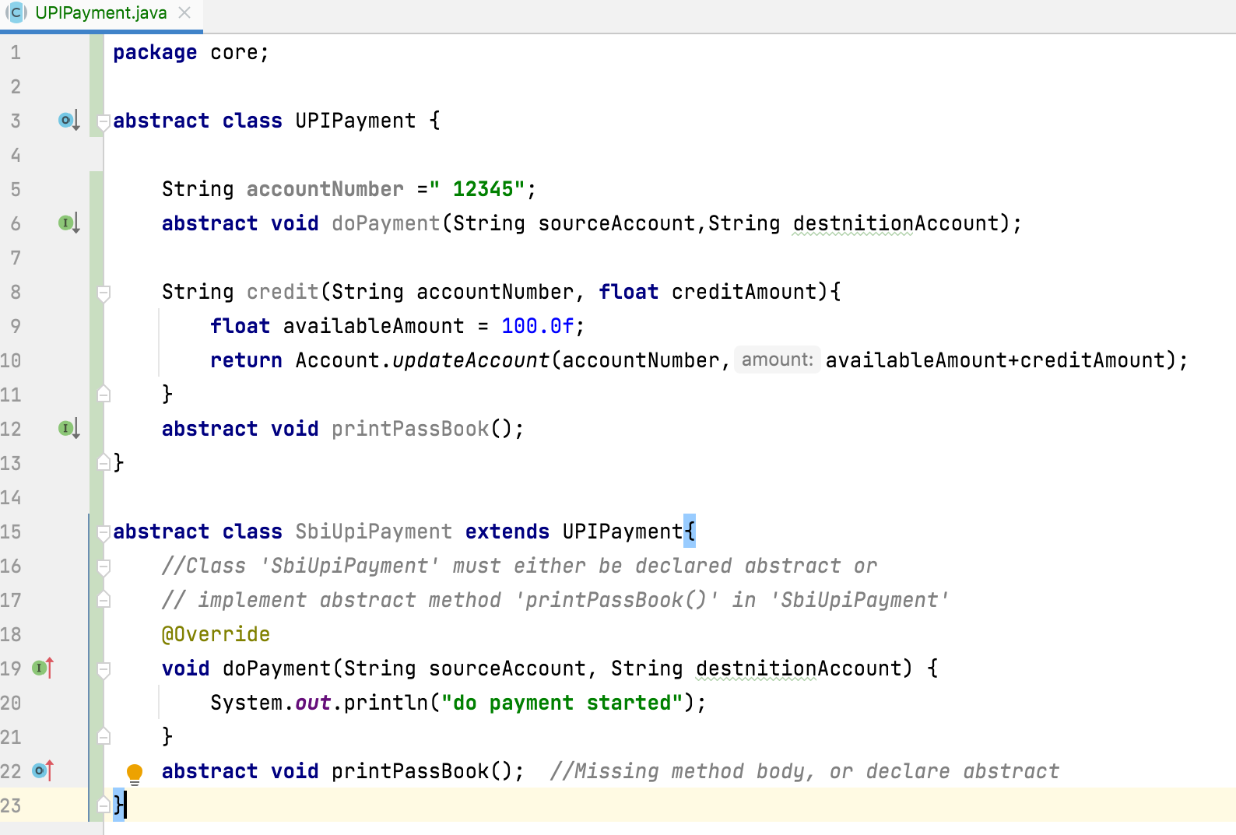
Abstract Class
The methods which are not implemented, or which don’t have definitions must be declared with ‘abstract’ keyword and the class which contains it must be also declared as abstract.
It is not compulsory that abstract class must have abstract methods. It may or may not have abstract methods.

Slide 6
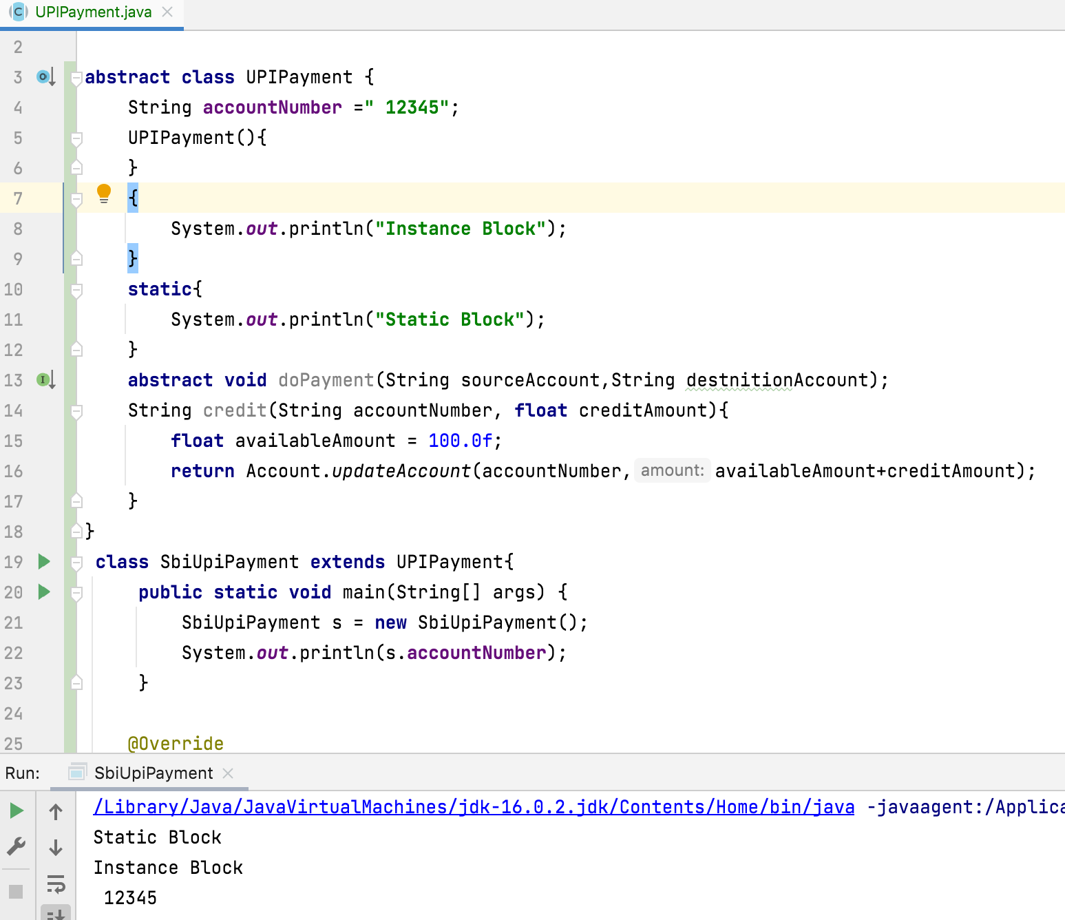
Abstract Class
abstract class, can contains any number of constructors. If you are not keeping any constructors, then compiler will keep default constructor.
Abstract class can have Instance Initialize Blocks Static Initialize Blocks

Slide 7
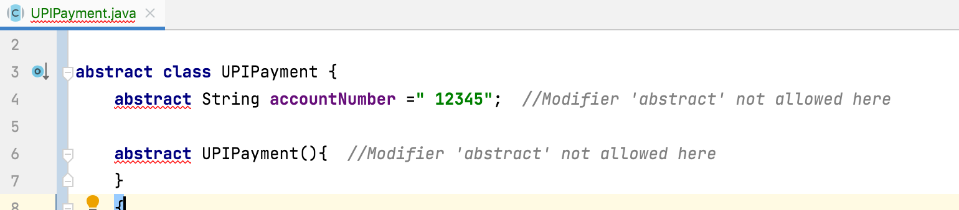
Abstract class
Constructors and fields can not be declared as abstract.

Slide 8
Note: All these combinations are illegal.
synchronized
static
private
final
Abstract
native
strictfp

Slide 9
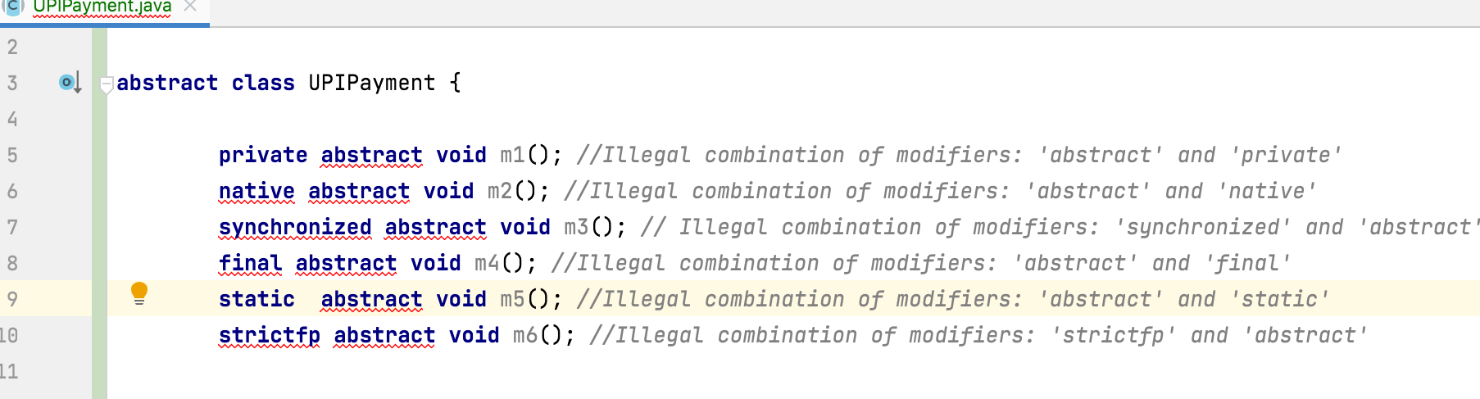
Note: All these combinations are illegal.

Slide 10
Thank You !
momedaram

